Slide 1
PRESENTATION ON CLOUD COMPUTING

Slide 2
INTRODUCTION
Cloud computing provides us a mean bt which we can access the application as utilities, over the Internet. It allows us to create, configure, and customize application online.
With cloud computing users can access database resourcrs via the internet from any where for as long as they need without worrying about any maintenance or management of actual resources.

Slide 3
What Is Cloud?
The term cloud refers to a Network Or Internet. In other words, we can say that cloud is something, which is present at remote location.
Cloud can provide services over network, i.e., on public network or on private network, i.e., WAN, LAN or VPN.
Application such as e-mail, web conferencing, customer relationship management(CRM), all run in cloud.

Slide 4
What is Cloud Computing?
Cloud Computing refers to manipulating, configuring, andaccessing the application online. It offers online data storage, infrastructure and application.
Cloud Computing is both a combination of software and hardware based computing resources delivered as a network service.

Slide 5
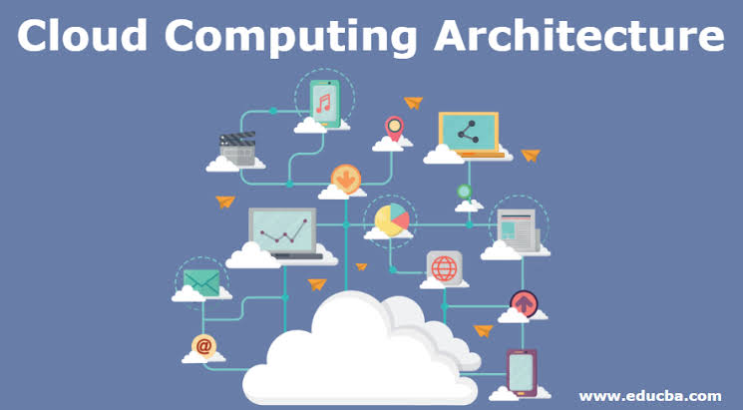

Slide 6
Basic Concepts
There are certain services and models working behind the scene making the cloud computing feasible and accesible to end users. Following are the working models for cloud computing:
Deployment models
Service models

Slide 7
Deployment Models
Deployment models define the type of access to the cloud, i.e., how the cloud located? Cloud can have any of the four types:
Public
Private
Hybrid
Community

Slide 8
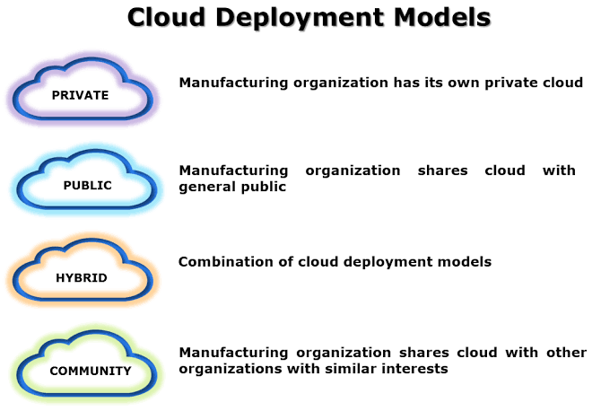

Slide 9
PUBLIC CLOUD: The Public cloud allows system and service to be easily accessible to the general public. Public cloud may be less secure because of its openness, e.g., e-mail.
PRIVATE CLOUD: The Private cloud allows systems and services to be accessible within an organization. It offers increased security because of its private nature.
COMMUNITY CLOUD: The community cloud allows systems and services to be accessible by group of organizations.
HYBRID CLOUD: The hybrid cloud is mixture of public and private cloud. However, the critical activities are performed using private cloud while the non-critical activities are performed using public cloud.

Slide 10
Service Models
Service models are the reference models on which the cloud computing is based. These can be categorized into three basic service models as listed :

Slide 11
Infrastructure as a service (IaaS)
Platform as a service (PaaS)
Software as a service (SaaS)

Slide 12
Infrastructure as a service (Iaas)
IaaS is the delivery of technology Infrastructure as an on demand scable service.
IaaS provides access to fundamemtal resourcrs such as physical machines, virtual machines, virtual storage, etc.
Usually billed on usage
Usually multi tenant virtualized environment
Can be coupled with Managed Services for OS and application support

Slide 13
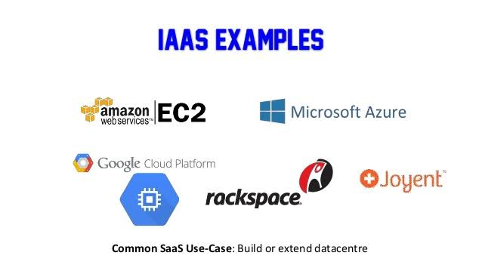

Slide 14
Platform as a Service (PaaS)
PaaS provides the runtime environment for applications, development and deployment tools, etc.
PaaS provides all of the facilities required to support the complete life cycle of building and delivering web application and service entirely from the Internet.
Typically application must be developed with a particular platform in mind
Multi tenant environments
Highly scalable multi tier architecture

Slide 15
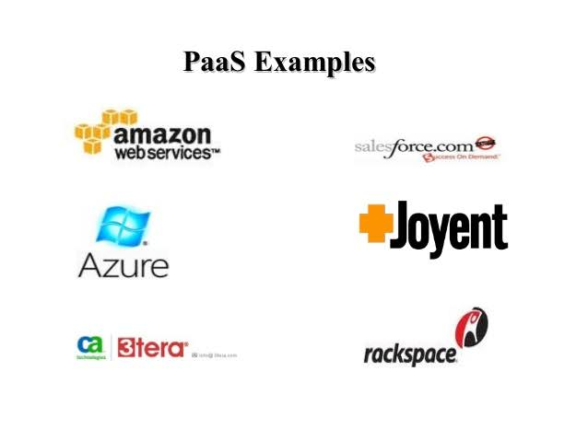

Slide 16
Software as a Service (SaaS)
SaaS model allows to use software applications as a service to end users.
SaaS is a software delivery methodology that provides licensed multi-tenant access to software and it's functions remotely as a web-based service
Usually billed based on range
Usually multi tenant environment
Highly scalable architecture

Slide 17
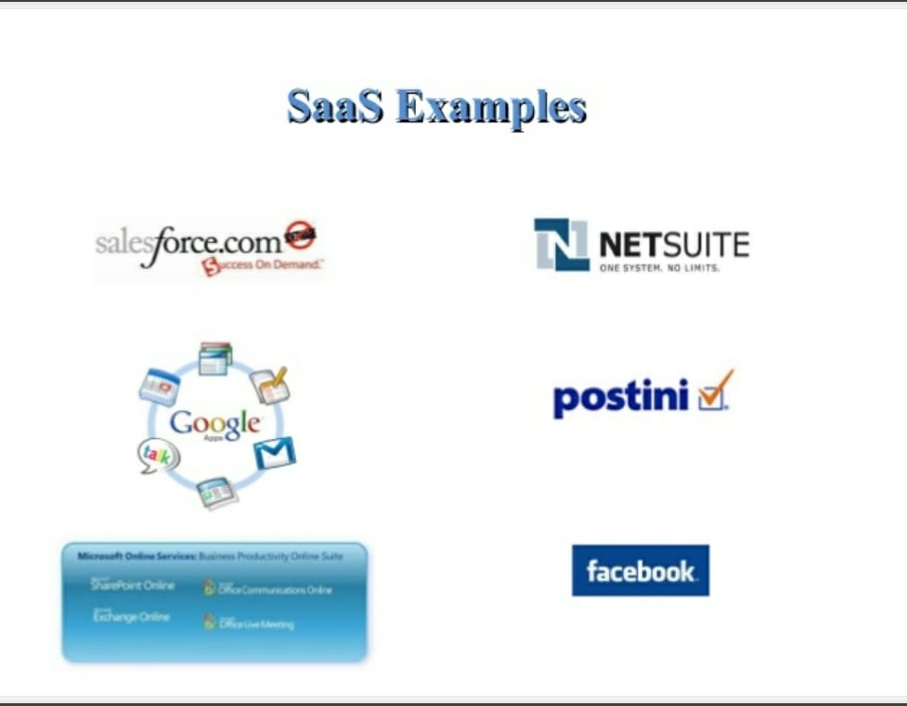

Slide 18
SERVICE LEVEL AGREEMENT(SLA)
Service level agreements in Cloud computingA Service Level Agreement (SLA) is the bond for performance negotiated between the cloud services provider and the client. Earlier, in cloud computing all Service Level Agreements were negotiated between a client and the service consumer. Nowadays, with the initiation of large utility-like cloud computing providers, most Service Level Agreements are standardized until a client becomes a large consumer of cloud services.

Slide 19
SLA are also defined at different levels which are mentioned below:
Windows Azure SLA –Window Azure has different SLA’s for compute and storage. For compute, there is a guarantee that when a client deploys two or more role instances in separate fault and upgrade domains, client’s internet facing roles will have external connectivity minimum 99.95% of the time.

Slide 20
SQL Azure SLA –SQL Azure clients will have connectivity between the database and internet gateway of SQL Azure. SQL Azure will handle a “Monthly Availability” of 99.9% within a month. Monthly Availability Proportion for a particular tenant database is the ratio of the time the database was available to customers to the total time in a month. Time is measured in some intervals of minutes in a 30-day monthly cycle.

Slide 21
Mobile Cloud Computing(MCC)
MCC is the combination of cloud computing and mobile computing to bring rich computational resources to mobile users, network operators, as well as cloud computing providers.The ultimate goal of MCC is to enable execution of rich mobile applications on a plethora of mobile devices, with a rich user experience.MCC provides business opportunities for mobile network operators as well as cloud providers

Slide 22
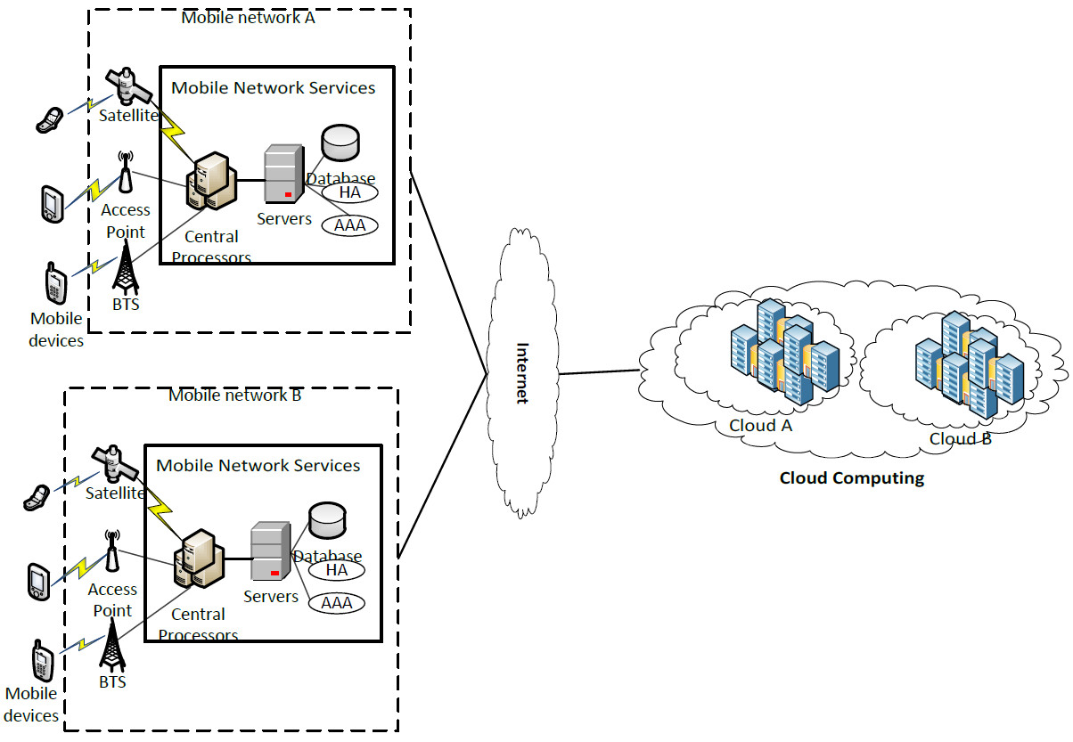

Slide 23
FOG COMPUTING
Fog computing or fog networking, also known as fogging, is an architecture that uses edge devices to carry out a substantial amount of computation, storage, and communication locally and routed over the Internet backbone.

Slide 24
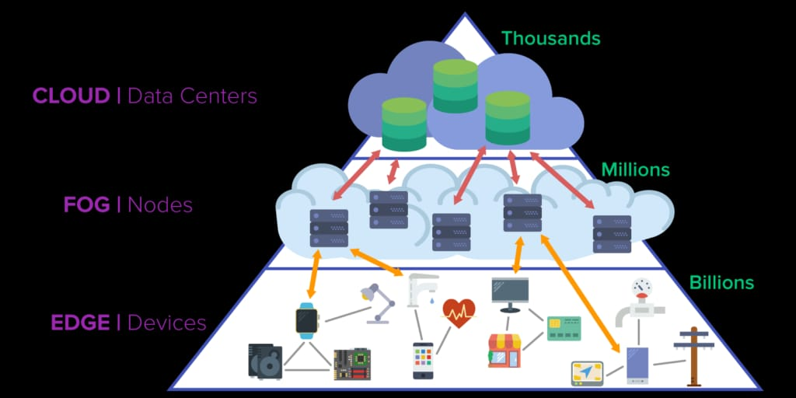

Slide 25
GREEN CLOUD
Green cloud is a buzzword that refers to the potential environmental benefits that information technology (IT) services delivered over the Internet can offer society. The term combines the words green -- meaning environmentally friendly -- and cloud, the traditional symbol for the Internet and the shortened name for a type of service delivery model known as cloud computing.

Slide 26
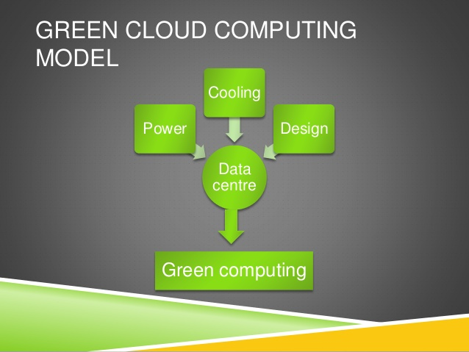

Slide 27
Advantages of Green Cloud Computing
Conserving Energy by Green Cloud Computing - In the year 2013, Google funded a project to measure the energy usage and carbon emission of cloud computing. The amount of constant power consumed for common software programs such as spreadsheets, email, and CRM systems to cloud is expected to reduce total energy consumption by 87% with this new project.

Slide 28
Remote Working reduces the Carbon Footprint in the Environment -The green cloud computing advantages seen in the organization today is remote working and flexibility to work from anywhere and anytime.

Slide 29
Disadvantages of Green Cloud Computing
Implementation Cost is High the initial investment for green computing is considered to be high by medium-sized and small organizations. Green computing is still not yet affordable to everyone.
Evolving Technology will be challenging to Adapt To.Green cloud computing technology is evolving, so it is slightly challenging for everyone to adapt to immediately.

Slide 30
PRESENTATION BY
- HARSHIT SAINI
SECTION- K
ROLL NUMBER- 25

